Slide 1

IST 659 DBMS
Presented by group Phi
E-Learning Platform
Developed by: Aditya Marathe, Gautam Balgi, and Rohan Gopalan
Notes:
Presented by Group Phi

Slide 2

Introduction
Welcome! We will explore e-learning platforms, discussing their benefits and key features. We created tables and utilized Power BI for visualization in our app, E-Learn.

Slide 3
Problem Statement
High Costs: Many platforms require expensive subscriptions or fees for certifications and
full access (e.g., Coursera, edX).
Quality Inconsistency: Platforms like Udemy often suffer from varying content quality due
to user-generated courses.
Limited Personalization: Most platforms fail to adapt to individual learning goals and preferences.
Lack of Engagement: Minimal real-time interaction and collaboration
reduce learner motivation (e.g., Coursera, Khan Academy).

Slide 4
Unlocking the Power of E-Learning
Accessibility
Flexibility
E-learning breaks down geographical barriers, making education accessible to anyone with an internet connection. Learning can happen anywhere, anytime.
Learn at your own pace and on your own schedule. Choose courses that fit your interests and goals, and manage your learning experience to fit your life.

Slide 5

Key Entities and Relationships
1
Users
Students, instructors, and administrators who interact with the platform.
2
Courses
Organized collections of learning materials, often divided into modules.
3
Scores
An E-Learning Platform for Grades simplifies education by providing digital tools for students and teachers to manage courses, track progress, and assess performance efficiently.
4
Assignments
Evaluations used to gauge learning progress, including quizzes, exams, and assignments.

Slide 6

Advanced Analytics and Reporting
Performance Tracking
1
Track user engagement, completion rates, and performance on assessments to identify areas for improvement.
Data-Driven Insights
2
Analyze data to understand learner behavior, identify trends, and improve the effectiveness of the platform.

Slide 7

Conclusion and Next Steps
E-learning platforms have revolutionized education, empowering learners to access knowledge and develop skills in flexible and engaging ways. As technology evolves, we can expect further innovations and advancements in e-learning, transforming the future of education for the better. We'll continue to explore and adopt these advancements, ensuring we remain at the forefront of the digital learning revolution.

Slide 8

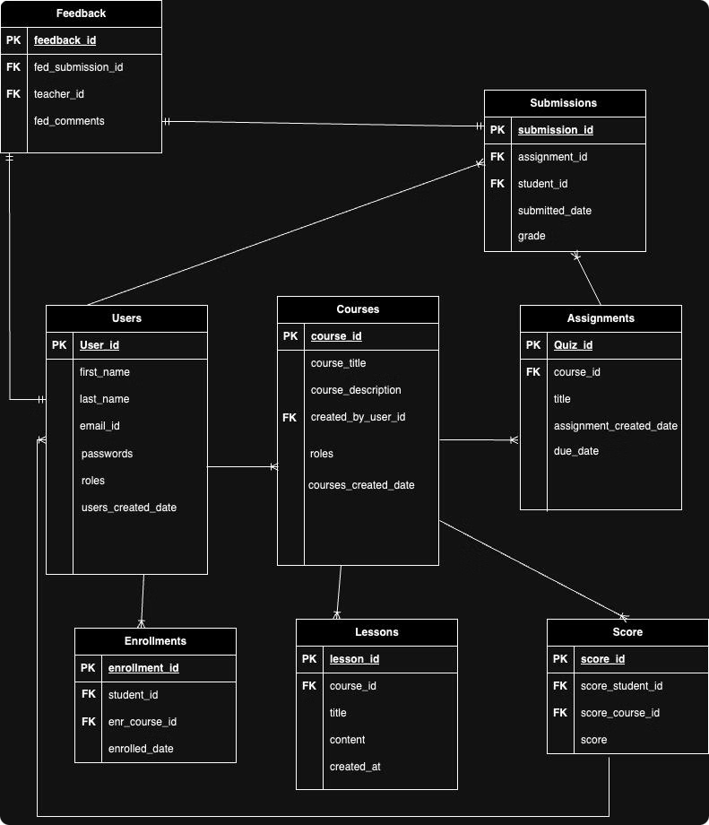
ERD Diagram
This ERD represents the database structure of an E-Learning Platform, showcasing relationships between key entities. It includes Users (students, teachers), Courses, and Lessons, along with Assignments, Submissions, and Feedback to manage learning content, assessments, and grading. Enrollments link students to courses, and the Score table tracks overall performance. This design ensures efficient handling of user roles, course management, and evaluations.
Notes:
This Entity Relationship Diagram represents the database structure for an E-Learning Platform It shows the key entities and their relationships, including Users (students and teachers), Courses, Lessons, Assignments, Submissions, and Feedback The Enrollments entity links students to the Courses they are taking The Score table tracks overall student performance across the platform This design allows for efficient management of user roles, course content, assessments, and grading

Slide 9
Relationship between the Data.
Submissions
submission_id, assignment_id, student_id, submitted_at, grade
Assignments, Feedback
One-to-Many
Feedback
feedback_id, submission_id, teacher_id, comments
Submissions, Users
One-to-One
score
score_id, student_id, course_id, score
Users, Courses
Many-to-One

Slide 10
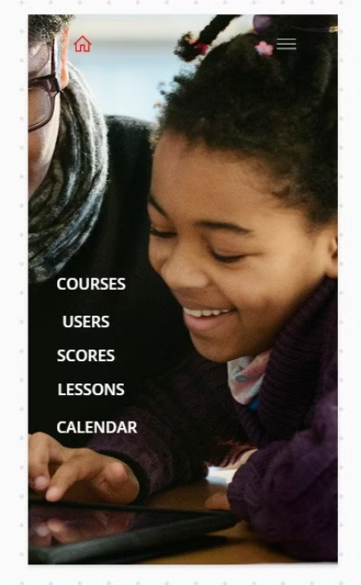
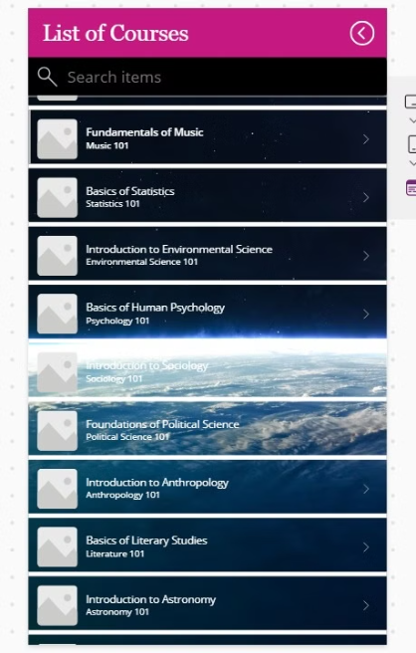
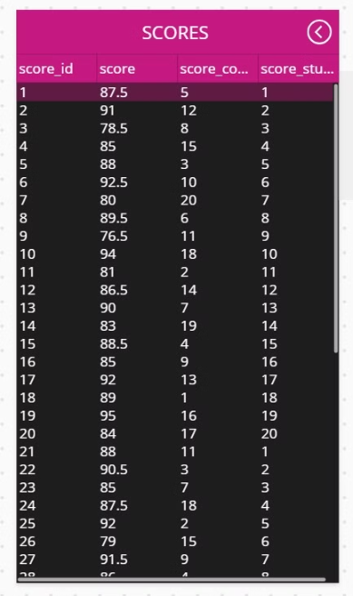
Power App
Power App Ex - 1
Power App Ex - 2
Power App Ex - 3

Slide 11
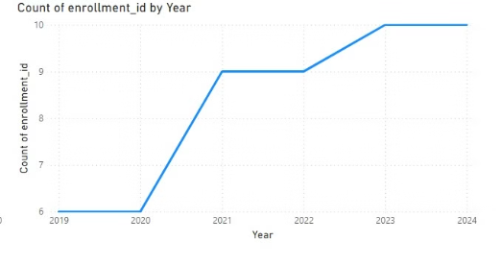
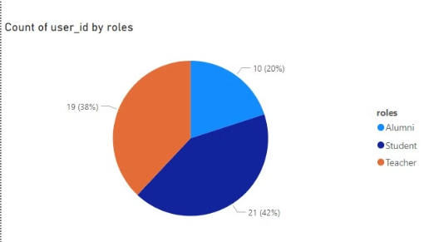
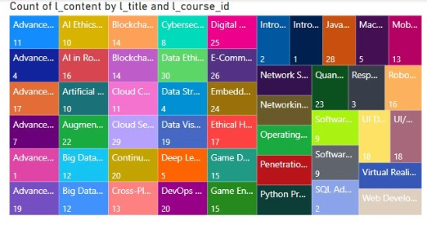
Power BI
Enrollment by year Power BI
Counts by user ID
Counts by Title and Course ID

Slide 12
Queries
Query
Purpose
Code Snippet
Insert Scores
Add low scores to the Scores table.
INSERT INTO Scores (score_id, score_student_id, score_course_id, score) VALUES (...);
Retrieve Enrolled Students
List students with their enrolled courses.
SELECT U.user_id, CONCAT(U.first_name, ' ', U.last_name), C.course_title FROM Enrollments ...;
Submissions with Feedback
Retrieve submissions, feedback, and teacher details.
SELECT S.submission_id, CONCAT(U.first_name, ' ', U.last_name), F.fed_comments, CONCAT(T.first_name, ...) ...;
Lessons by Course
Retrieve all lessons under each course.
SELECT L.lesson_id, C.c_course_id, C.course_title, L.l_title FROM Lessons L JOIN Courses C ON ...;
Courses Without Enrollments
Find courses with no student enrollments.
SELECT C.c_course_id, C.course_title FROM Courses C LEFT JOIN Enrollments E ON C.c_course_id = ...;
Low Scores (<50)
Retrieve students with scores below 50.
SELECT U.user_id, CONCAT(U.first_name, ' ', U.last_name), C.course_title, S.score FROM Scores ... WHERE S.score < 50;
High Scores (>90)
Retrieve students with scores above 90.
SELECT S.score_id, CONCAT(U.first_name, ' ', U.last_name), C.course_title, S.score FROM Scores ... WHERE S.score > 90;
Courses by Teacher (Procedure)
Retrieve courses created by a specific teacher.
CREATE PROCEDURE GetCoursesByTeacher (@teacher_id INT) AS BEGIN SELECT ...; END; EXEC GetCoursesByTeacher ...;
Assignments by Course (Procedure)
Retrieve assignments for a specific course.
CREATE PROCEDURE GetAssignmentsByCourse (@course_id INT) AS BEGIN SELECT ...; END; EXEC GetAssignmentsByCourse ...;
Average Score Per Course
Calculate the average score for each course.
SELECT C.c_course_id, C.course_title, AVG(S.score) AS AverageScore FROM Scores ... GROUP BY C.c_course_id ...;
Update Roles for Graduates
Update student roles to "Alumni" after graduation.
UPDATE Users SET roles = 'Alumni' WHERE roles = 'Student' AND user_id IN (SELECT ...);
Delete Old Feedback
Remove feedback older than one year.
DELETE FROM Feedback WHERE EXISTS (SELECT 1 FROM Submissions ... WHERE S.submitted_date < DATEADD(YEAR, -1, ...);
Top 5 Students by Score
Retrieve the top 5 students with the highest scores.
SELECT TOP 5 S.score_id, CONCAT(U.first_name, ' ', U.last_name), C.course_title, S.score FROM Scores ...;
Index: Enrollments by Student
Create an index for faster enrollment queries by student.
CREATE INDEX IDX_Enrollments_Student ON Enrollments (student_id);
Index: Assignments by Course
Create an index for faster assignment queries by course.
CREATE INDEX IDX_Assignments_Course ON Assignments (asg_course_id);

Slide 13
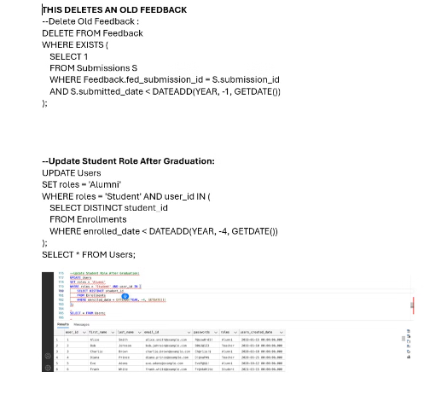
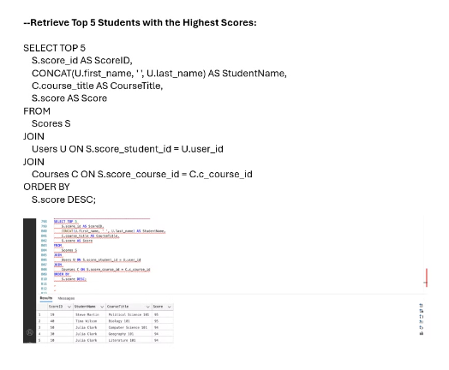
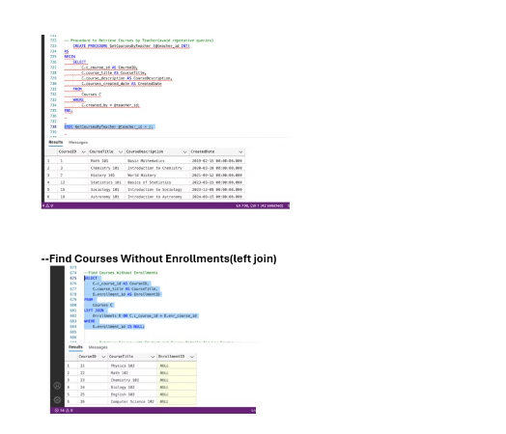
Project Queries
For this project, we used 2 approaches: Python and Power App.
Retrieves top 5 students with highest scores
Find Courses
This Deletes the Old Feedback

Slide 14
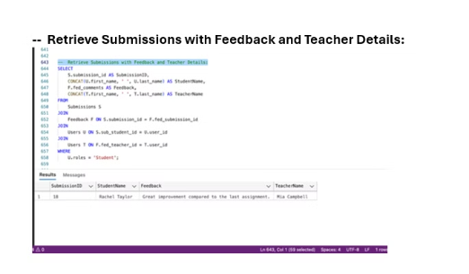
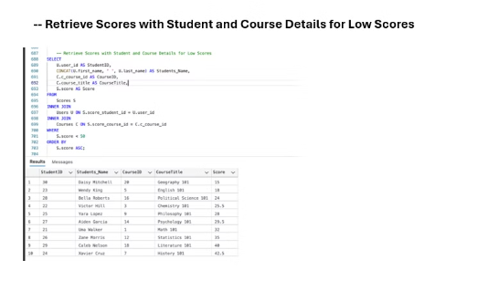
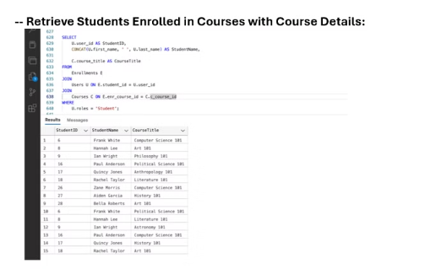
Project Queries Pt. 2
Retrieve with Feedback
Retrieve Scores
Retrieve Courses

Slide 15

Thank You.

